Slide 1
Container Security: Issues, Challenges, and the Road Ahead

Slide 2
TERMINOLOGIES
Sandbox: An isolated testing environment that enables the user to run programs or open files without affecting the application. This is mainly used to test potentially malicious software.
CVE: Common Vulnerabilities and Exposures.
ShellShock: This is a security bug. It enables an attacker to cause to bash to execute arbitrary command.

Slide 3
TERMINOLOGIES(Contd.)
Root Privileges: A user with this privileges can read or write any files on the system.
SSH(Secure Socket Shell): It enables remote access. It is a network protocol that gives users specially system administrator, a secure way to access a computer over an unsecured network
Privilege escalation: When an attacker logs into the host system using an account with elevated access privileges.

Slide 4
TERMINOLOGIES(Contd.)
SlowLoris: Slow http DoS attack. This attack exploits the fact that Apache wait for complete http headers to be received before closing a http connection. An attacker can send multiple incomplete GET request to keep the connections open in order to block other users from getting their request processed by the server.
Syn Flood: It may happen during 3-way handshake in TCP connection establishment phase. Attacker will send tons of SYN packets.

Slide 5
TERMINOLOGIES(Contd.)
ICMP flood or Ping flood attack: Attacker attempts to overwhelm a targeted device with ICMP echo request.
MAC flooding: Switch contains table of MAC address. An attacker will fed many ethernet frames containing many MAC addresses to force legitimate MAC address out of the MAC address table.
Shocker: A tool to find and exploit servers’ vulnerability to shellshock

Slide 6
TERMINOLOGIES(Contd.)
Dirty COW: COW means copy on write. Because of the race condition(in linux kernel memory subsystem), with the right timing a local attacker can exploit the COW mechanism to turn a read only mapping of a file in a writable mapping.(Details:Dirty Cow (toronto.edu))
Fine Grained Access: A method of controlling who can access certain data. It gives each item of data its own specified policy for access depending on the role of the person requesting the date and the intended action upon the data(CAPABILITY)

Slide 7
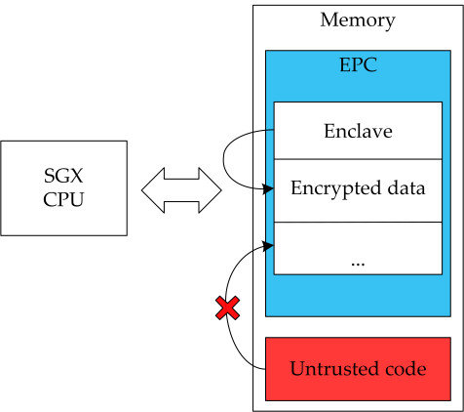
TERMINOLOGIES(Contd.)
Intel SGX: SGX means Software Guard Extensions. The primary SGX abstraction is SGX: an isolated execution environment within the virtual address space. The code and data in the enclaved memory do not leave leave the CPU package unencrypted.

Slide 8
TERMINOLOGIES(Contd.)
Kubernets Orchestration: It allows a user to build app services that span multiple containers, schedule containers across a cluster, scale those containers and manage their health over time.
Controlled Channel Attack: Page tables in processors are handled by OS. When a page fault occurs, the MMU(Memory management unit) then reveals the required page to the OS for the page fault handler to handle page fault. Now if the OS is malicious it can obtain valuable informations from here.

Slide 9
TERMINOLOGIES(Contd.)
Heartbleed Bug: This is a bug in OpenSSL cryptographic software library. It results from improper input validation in the implementation of TLS heartbeat extension. It causes buffer Overread(more data can be read than should be read.)
Forkbomb Attack(Rabbit Attack): In this attack, fork system is recursively used until all system resources execute a command. During this attack, keyboard inputs are ignored and creates kernel panic

Slide 10
TERMINOLOGIES(Contd.)
vTPM(Virtual Trusted Platform Modules): This is an open source virtual machine monitor developed by Cambridge University. It provides hardware based security related function like random number generation, attestation and key generation. For example, It helps OS to generate private key and store it but these keys are not exposed to OS. As a result, even if OS is corrupted clients data is secured.

Slide 11
THANK YOU

